Slide 1





JavaScript Advanced
Course Overview
Advanced
JavaScript Advanced
SoftUni Team
Technical Trainers
Software University
http://softuni.bg

Slide 2



Table of Contents
Course Objectives
Course Program
Trainers Team
Course Schedule
Exams and Evaluation
Learning Resources

Slide 3
Have a Question?
sli.do #9077

Slide 4

JS Core Module @ SoftUni
JavaScript Core
Intensive 4 Months JavaScript Training

Slide 5
JS Core Module Goals
4 months intensive JavaScript development training
5 times weekly, lots of live coding, homework and projects
Part I – JS Fundamentals
JS programming, functions, arrays, strings, objects, JSON, …
Part II – JS Advanced
jQuery, DOM, object composition, classes, modules, unit testing
Part III – JS Apps
REST, AJAX, promises, MVC, ReactJS, routing, building SPA

Slide 6
JS Core Module at SoftUni – Timeline
19-Sep-2016
17-Oct-2016
14-Nov-2016
11-Dec-2016
23-Dec-2016
JavaScript
Fundamentals
Lessons + exercises + team work project + exam
4 weeks * 5 times / week
9 credits
Start: 19-Sept-2016
Final exam: 16-Oct-2016
JavaScript Advanced
Lessons + exercises + exam
4 weeks * 5 times / week
9 credits
Start: 17-Oct-2016
Final exam: 13-Nov-2016
JavaScript Applications
Lessons + exercises + team work project + exam
4 weeks * 5 times / week
9 credits
Start: 14-Nov-2016
Final exam: 11-Dec-2016
Re-Take Exams
3 exams @ one week
16-Dec
19-Dec
22-Dec
Christmas Holidays
2 weeks holiday

Slide 7
Professions @ SoftUni
Java
Fund.
Java
DB
Java
Web
Programming Basics
C#
Fund.
C#
DB
C#
Web
Tech Module
JS Core Module
MEAN
Stack
Web
Basics
PHP
Fund.
PHP
Web
Web
Basics
https://softuni.bg/curriculum
https://softuni.bg/trainings/courses

Slide 8

JavaScript Advanced
Advanced
Course Objectives & Program

Slide 9

Course Objectives
The JavaScript Advanced course provides
Advanced coding skills for the JS language
Extends the JS Fundamentals course
Covers DOM, advanced functions, IIFE, object composition, unit testing, classes and inheritance, modules, transpilers, exceptions, generators, iterators
What is NOT covered?
JS technologies (AJAX, AngularJS, ReactJS, promises)

Slide 10
Course Topics
DOM and BOM, Manipulating the DOM Tree
jQuery: Simplified DOM and Events
Advanced Functions: IIFE, this, call, apply, bind
Object Composition and Revealing Modules
Unit Testing with Mocha and Sinon
Classes and Members
Class Inheritance and Prototype Chain

Slide 11
Course Topics (2)
Modules, Babel Transpiler, CommonJS
Error Handling and Exceptions
Generator Functions and Iterators
Exam Preparation
JS Patterns and Best Practices
Mini Teamwork
Practical Exam

Slide 12
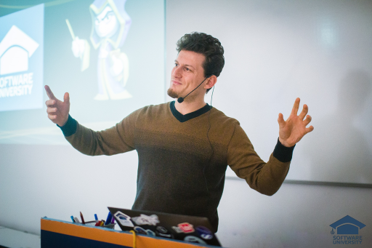
The Trainers Team

Slide 13
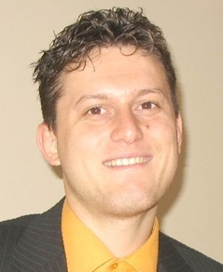
Trainers Team
Svetlin Nakov, PhD
Training & Inspiration Manager @ Software University (SoftUni)
20+ years software development experience
10+ years experience as trainer
Author of 7 programming books
Speaker at hundreds of events
Winner in International programming contests and Olympiads
Web site & blog: www.nakov.com

Slide 14
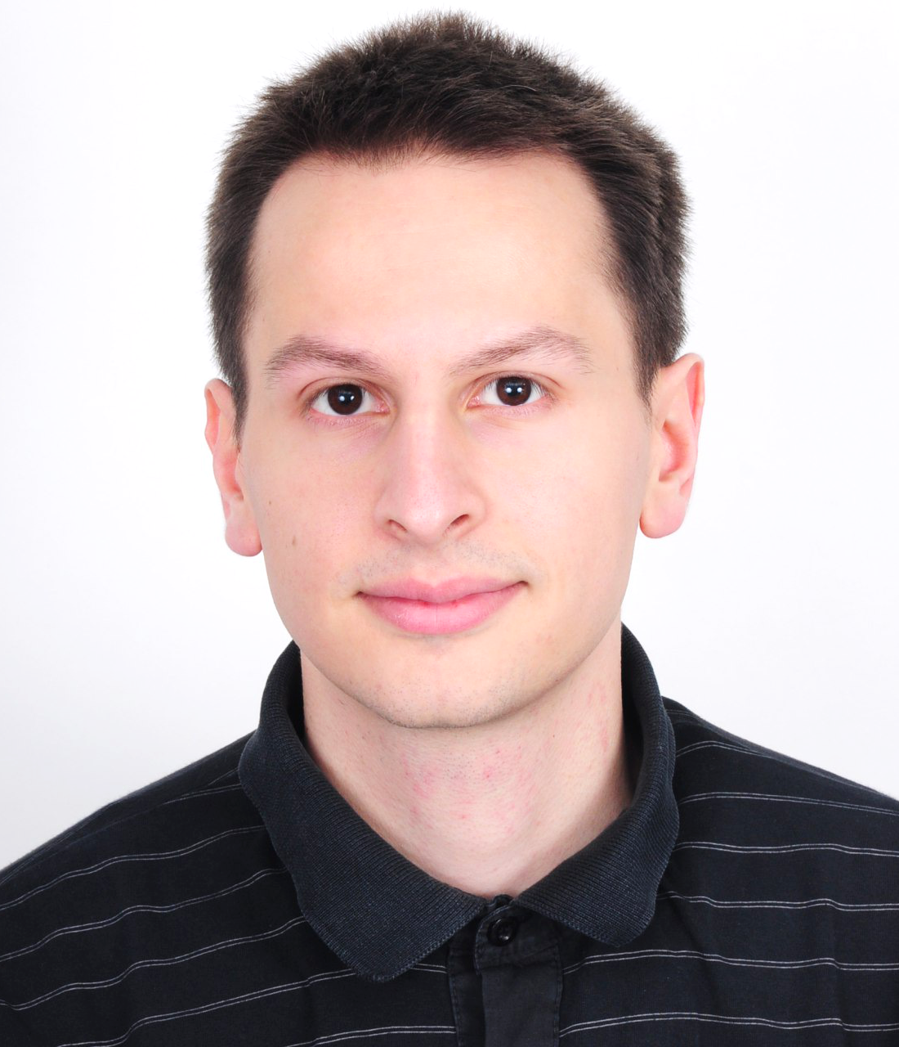
Trainers Team (2)
Viktor Kazakov
Technical Trainer @ Software University
Top performing student from the Software University
Interested in data structures and algorithms
Writes mostly in C#, but also knows C, C++, Java and JavaScript

Slide 15
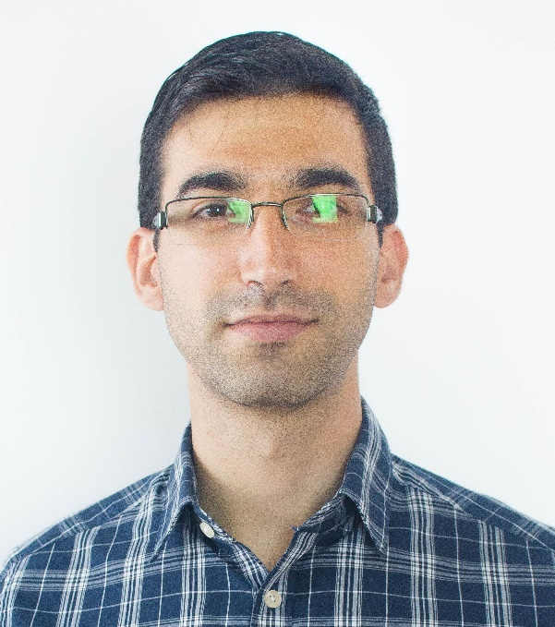
Trainers Team (3)
Viktor Kostadinov
Technical Trainer @ Software University
Programmed as a hobby since high school
Developed a resource-sharing website during his university years
Top performing student from the Software University
Interests include astronomy and game development

Slide 16
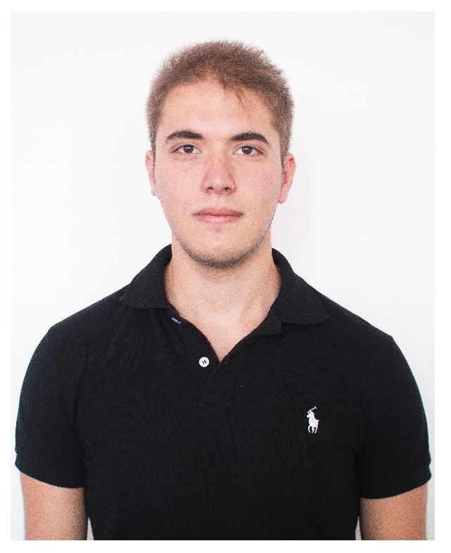
Trainers Team (4)
Ivaylo Zhelev
Technical Trainer @ Software University
Top performing student from the Software University
Interested in security and game development
Currently, writes mainly in JavaScript

Slide 17
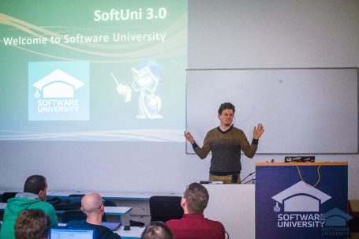


JavaScript Advanced
Course Details and Schedule

Slide 18
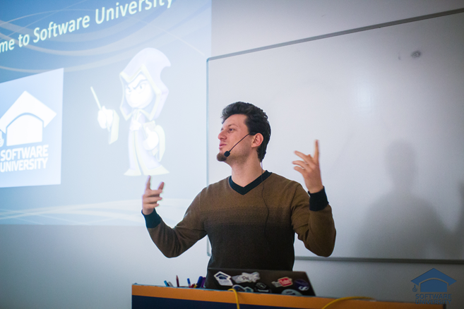
Training Duration and Schedule
Lessons: ~ 20 hours (onsite + YouTube videos)
Practical exercises (in class): ~ 60 hours
Homework: ~ 0-80 hours
Exam: 6 hours
Time frame
Oct – Nov 2016

Slide 19


Why English?
Why the slides are in English?
English is the native language of the software engineers
Specific terminology should be in English
Translations are inaccurate and funny
Just learn English!
No excuses

Slide 20


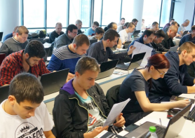
JavaScript Advanced
Evaluation Criteria

Slide 21


Scoring System for the Course
Mandatory:
Final exam – 85%
Homework submissions – 15%
Bonuses:
Teamwork – 5% bonus
Presence in class – 5% bonus
Forum activity – bonus up to 5%

Slide 22


Homework Assignments
Your homework is mainly work in class!
Lesson days → slides + live demos + exercises
Exercise days → only exercises
How to submit your homework?
Some submitted in the judge system
Others uploaded in the course Web site
Homework assignments are due in 7 days

Slide 23

Teamwork Project
Mini teamwork
For onsite students only
Build a team of 3 persons
Choose your teammates in class
You will be given a project assignment
5 problems: classes, inheritance, modules, unit-testing, DOM
Work on the project in class with your team
All team members get the same score

Slide 24










Resources
What We Need Additionally?

Slide 25



Course Web Site, Forum and FB Group
Official web site:
Official discussion forum:
Official Facebook group:
softuni.bg/courses/javascript-advanced
softuni.bg/forum/categories/19
fb.com/groups/jscoresept2016

Slide 26

The Programming Basics Slides and Videos
All lecture slides, videos, homework assignments, projects and other resources are open content, available for free
Visit the course web site to access the course resources

Slide 27



Recommended Software
Software needed for this course:
Noje.js – https://nodejs.org
WebStorm – https://jetbrains.com/webstorm/
Optionally:
Visual Studio – https://www.visualstudio.com

Slide 28
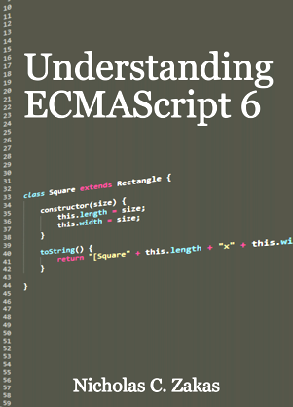


Recommended Books
Understanding ECMAScript 6 (by Nicholas Zakas)
https://leanpub.com/understandinges6/read
Exploring ES6: Upgrade to the next version of JavaScript (by Axel Rauschmayer)
http://exploringjs.com
Exploring ES2016 and ES2017 (by Axel Rauschmayer)
https://leanpub.com/exploring-es2016-es2017/

Slide 29

Recommended Books
Learning JavaScript Design Patterns (by Addy Osmani)
https://addyosmani.com/resources/essentialjsdesignpatterns/book/

Slide 30









JavaScript Advanced – Course Overview
https://softuni.bg/courses/javascript-advanced

Slide 31
License
This course (slides, examples, demos, videos, homework, etc.) is licensed under the "Creative Commons Attribution-NonCommercial-ShareAlike 4.0 International" license

Slide 32






Free Trainings @ Software University
Software University Foundation – softuni.org
Software University – High-Quality Education, Profession and Job for Software Developers
softuni.bg
Software University @ Facebook
facebook.com/SoftwareUniversity
Software University @ YouTube
youtube.com/SoftwareUniversity
Software University Forums – forum.softuni.bg

